Slide 1

Image Segmentation: Point, Line and Edge Detection
CS4055 Digital Image Processing

Slide 2

Contents
So far we have been considering image processing techniques used to transform images for human interpretation
Today we will begin looking at automated image analysis by examining the thorny issue of image segmentation:
The segmentation problem
Finding points, lines and edges

Slide 3
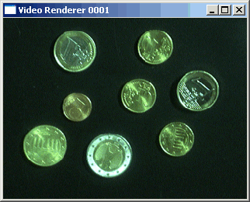
The Segmentation Problem
Segmentation attempts to partition the pixels of an image into groups that strongly correlate with the objects in an image
Typically the first step in any automated computer vision application

Slide 4
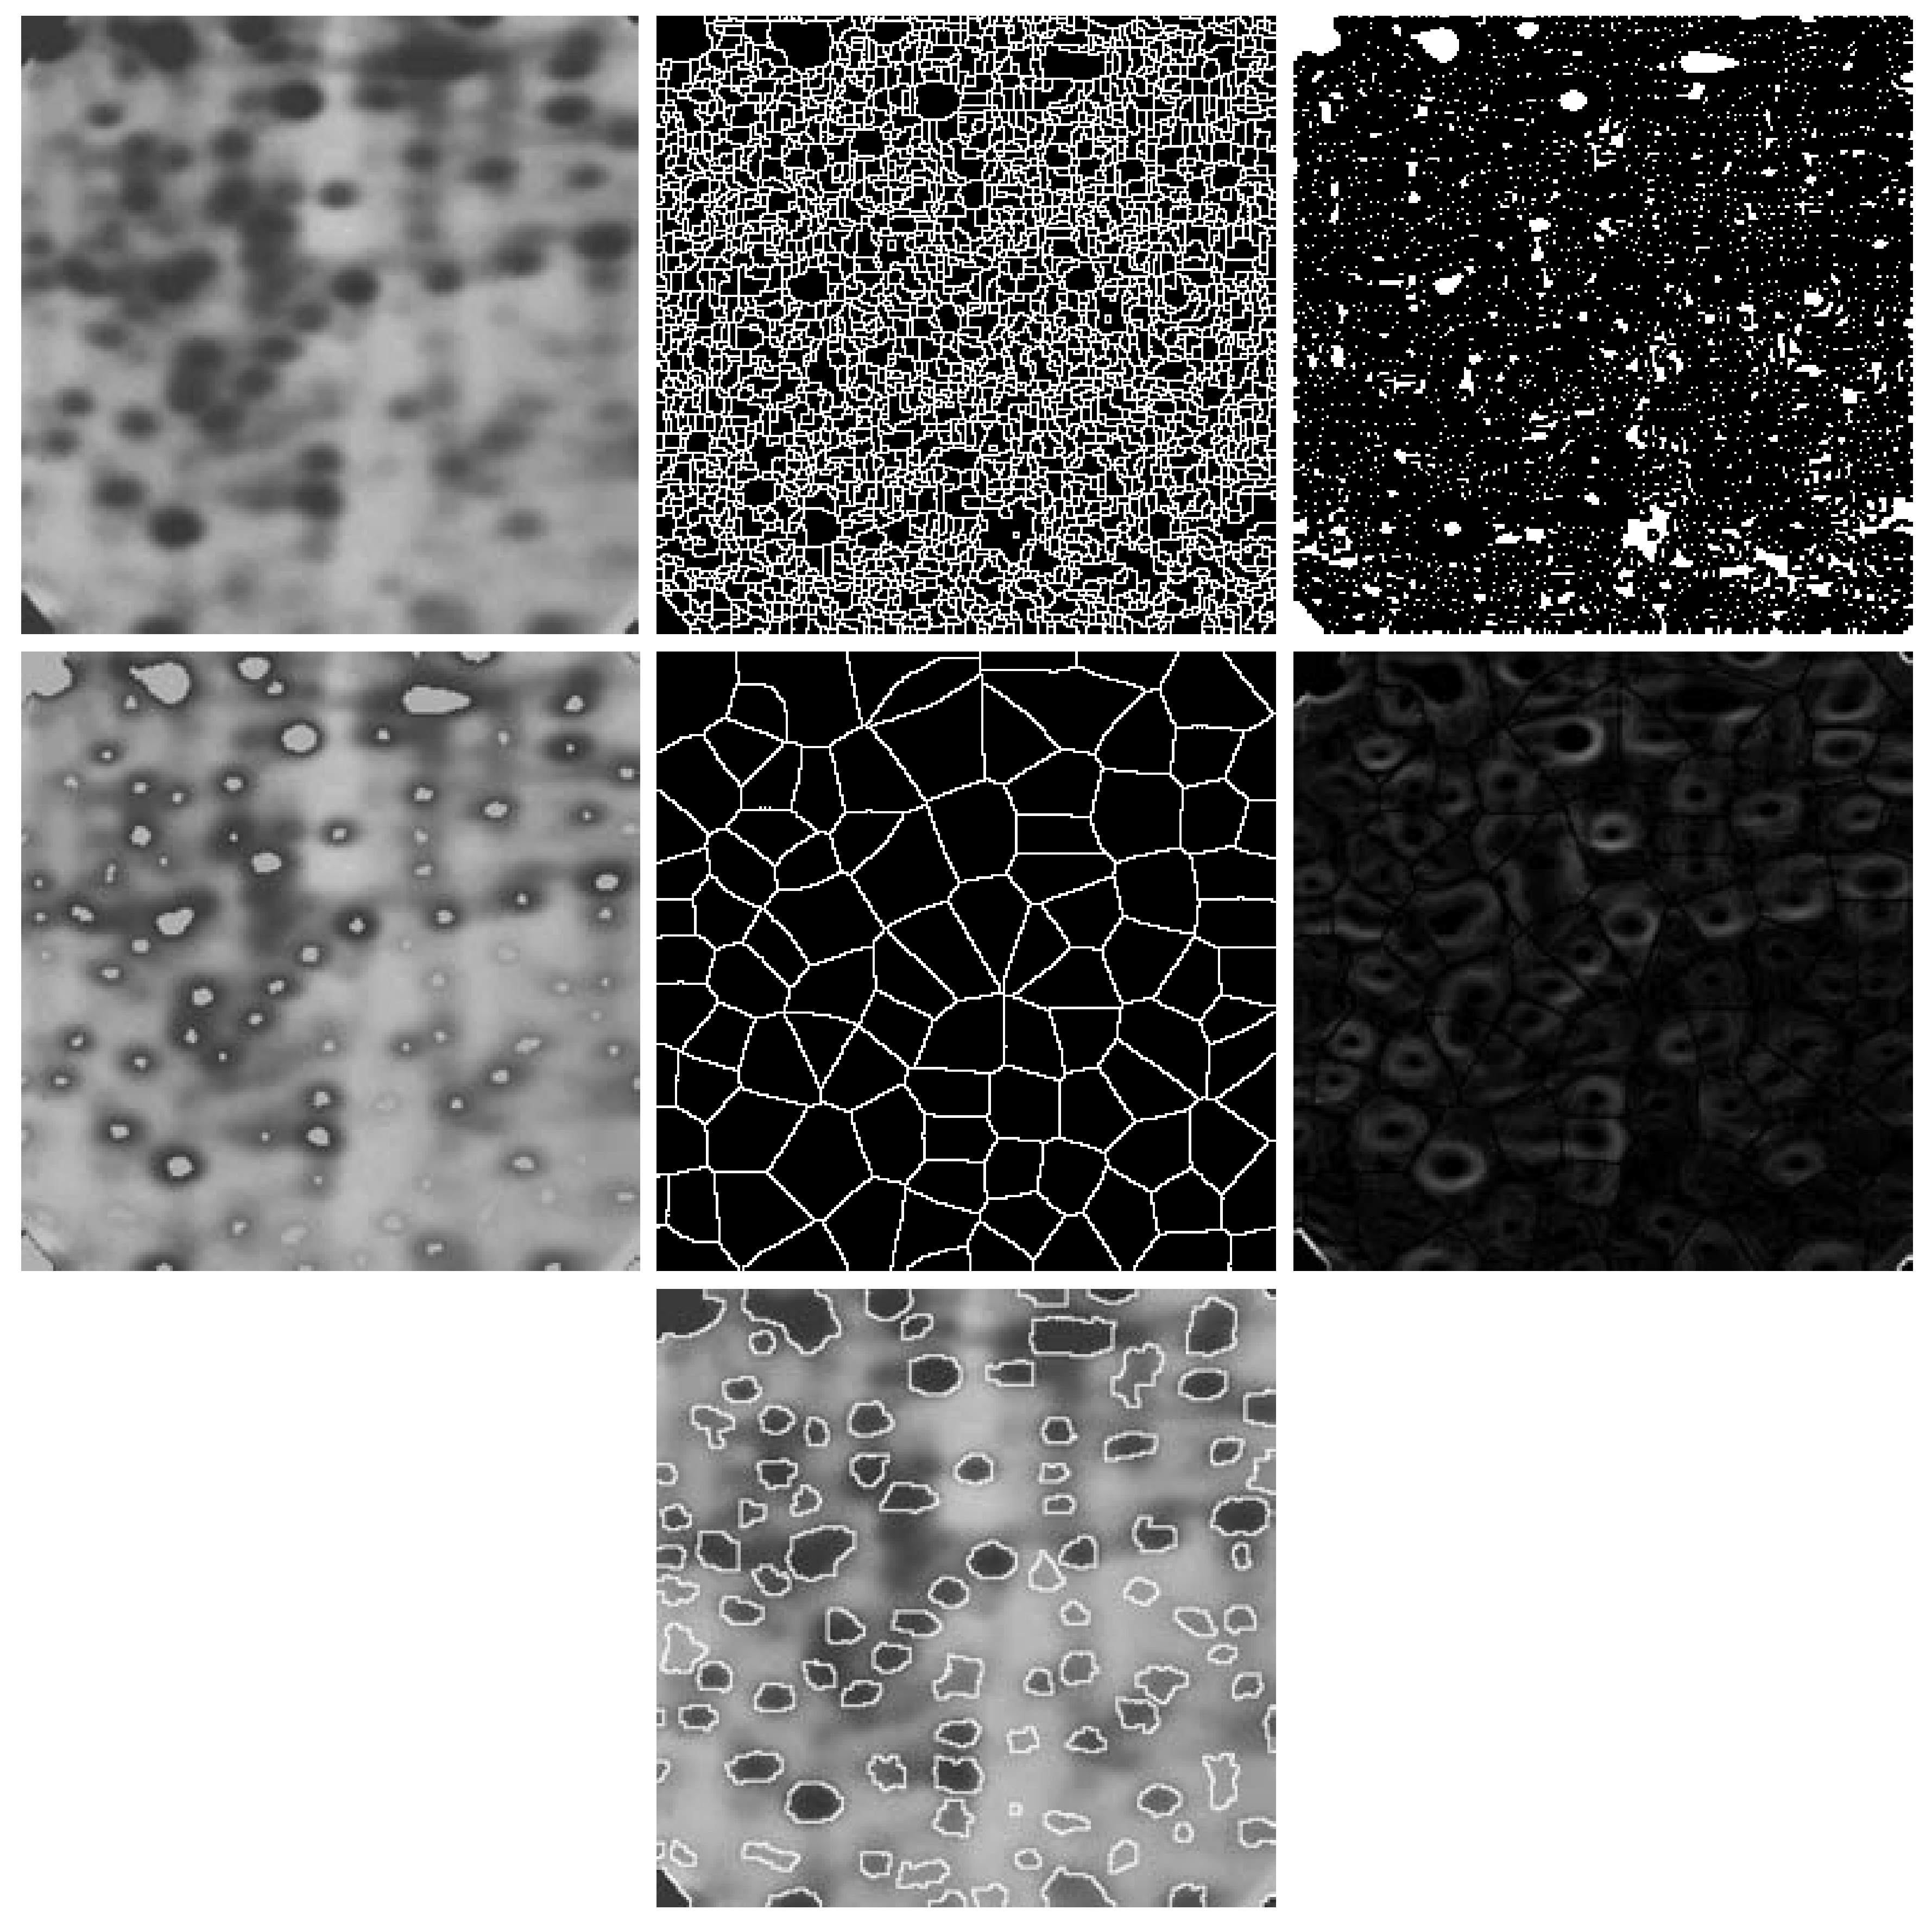
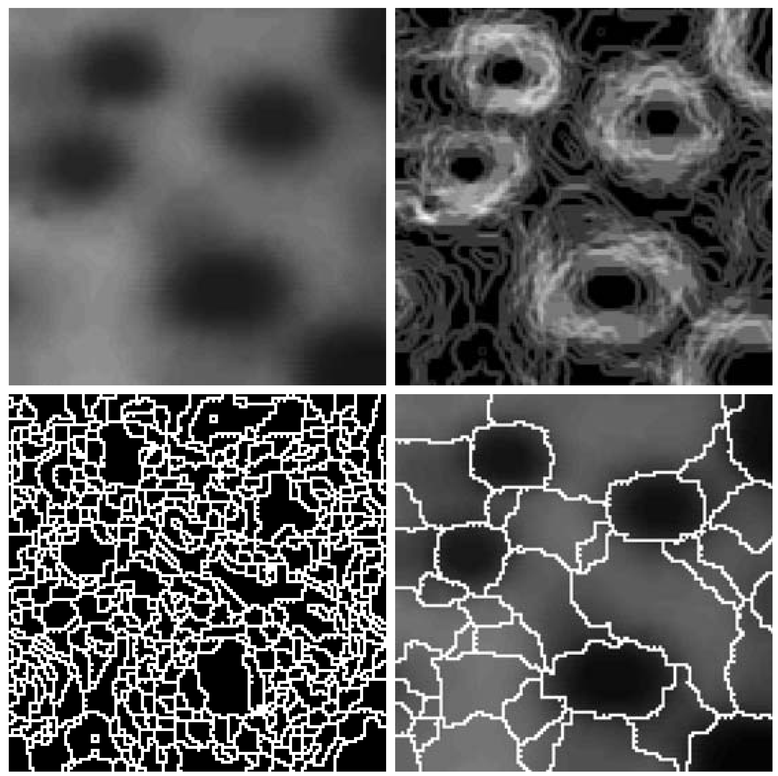
Segmentation Examples

Slide 5
Detection Of Discontinuities
There are three basic types of grey level discontinuities that we tend to look for in digital images:
Points
Lines
Edges
We typically find discontinuities using masks and correlation

Slide 6
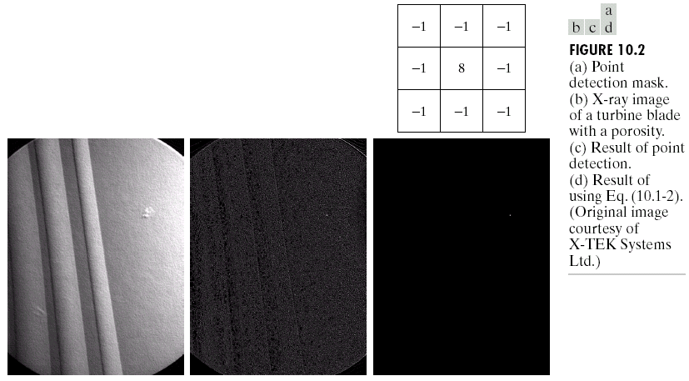
Point Detection
Point detection can be achieved simply using the mask below:
Output 1 if:
Else output 0.
Points are detected at those pixels in the subsequent filtered image that are above a set threshold
R is called Response of the filter.

Slide 7
Point Detection (cont…)
X-ray image of a turbine blade
Result of point detection
Result of thresholding

Slide 8
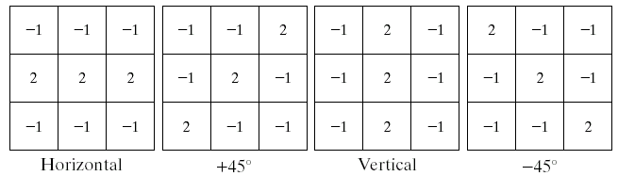
Line Detection
The next level of complexity is to try to detect lines
The masks below will extract lines that are one pixel thick and running in a particular direction

Slide 9
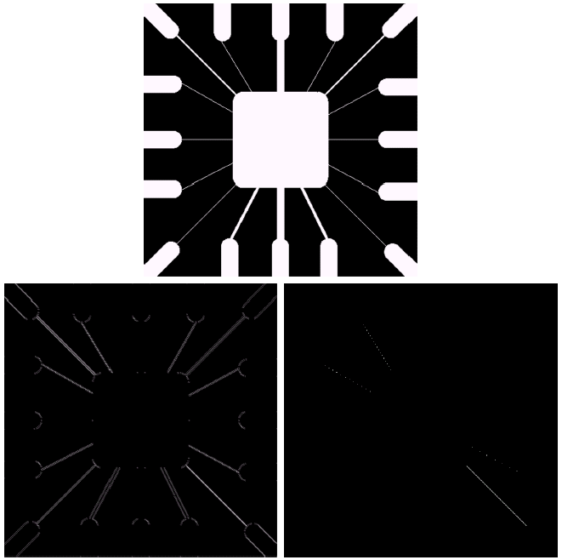
Line Detection (cont…)
Binary image of a wire bond mask
After processing with -45° line detector
Result of thresholding filtering result

Slide 10
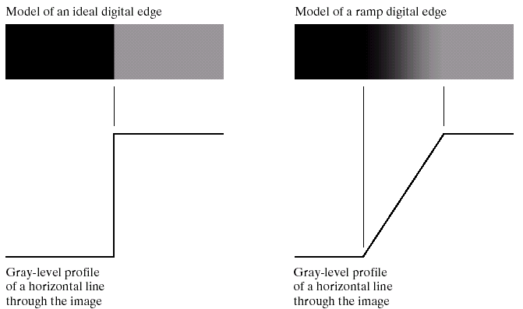
Edge Detection
An edge is a set of connected pixels that lie on the boundary between two regions

Slide 11
Edge Point
We define a point in an image as being an edge point if its 2-D 1st order derivative is greater than a specified threshold.
A set of such points that are connected according to a predefined criterion of connectedness is by definition an edge.

Slide 12
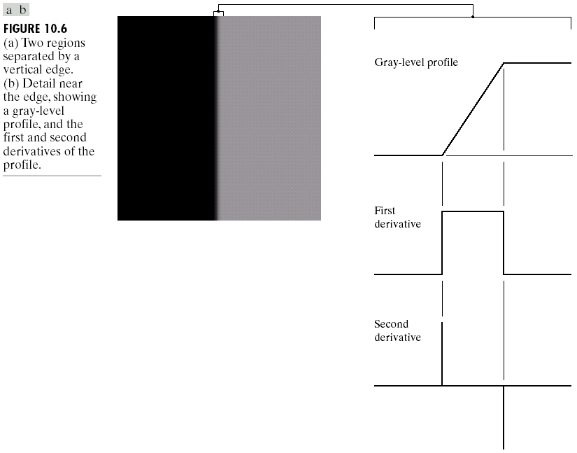
Edges & Derivatives
We have already spoken about how derivatives are used to find discontinuities
1st derivative tells us where an edge is
2nd derivative
show double
response with thin
edges

Slide 13
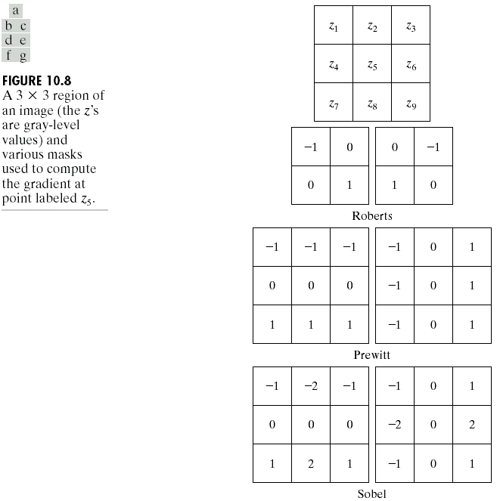
Common Edge Detectors
Given a 3*3 region of an image the following edge detection filters can be used

Slide 14
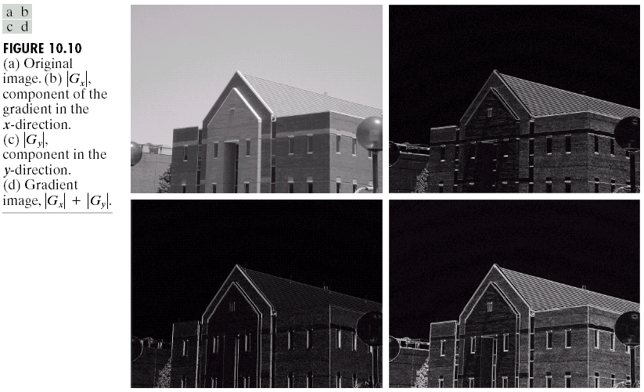
Edge Detection Example
Original Image
Horizontal Gradient Component
Vertical Gradient Component
Combined Edge Image

Slide 15
Edge Detection Example

Slide 16
Edge Detection Example

Slide 17
Edge Detection Example

Slide 18
Edge Detection Example

Slide 19
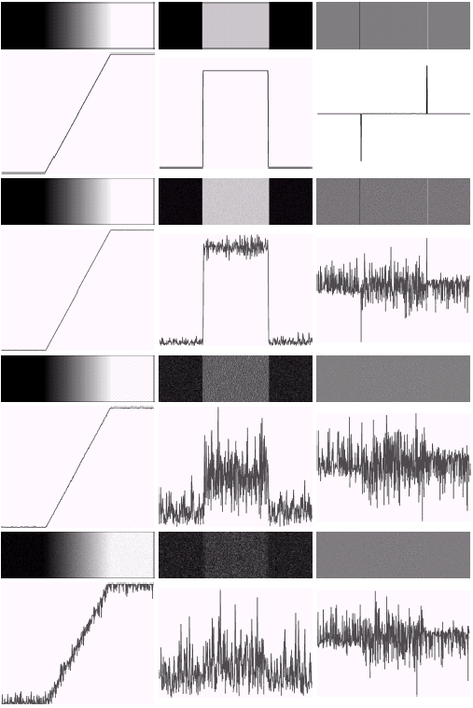
Derivatives & Noise
Derivative based edge detectors are extremely sensitive to noise
We need to keep this in mind

Slide 20
Edge Detection Problems
Often, problems arise in edge detection in that there is too much detail
For example, the brickwork in the previous example
One way to overcome this is to smooth images prior to edge detection

Slide 21
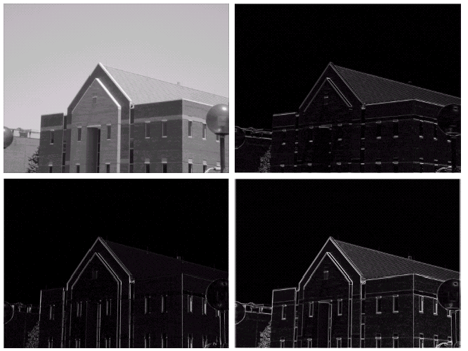
Edge Detection Example With Smoothing
Original Image
Horizontal Gradient Component
Vertical Gradient Component
Combined Edge Image

Slide 22
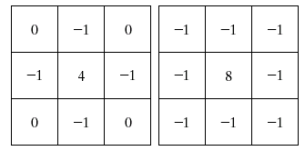
Laplacian Edge Detection
We encountered the 2nd-order derivative based Laplacian filter already
The Laplacian is typically not used by itself as it is too sensitive to noise
Usually used for edge detection the Laplacian is combined with a smoothing Gaussian filter

Slide 23
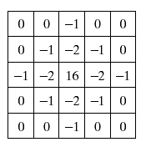
Laplacian Of Gaussian
The Laplacian of Gaussian (or Mexican hat) filter uses the Gaussian for noise removal and the Laplacian for edge detection
The Gaussian function
The Laplacian of Gaussian function
Digital approximation of LoG

Slide 24
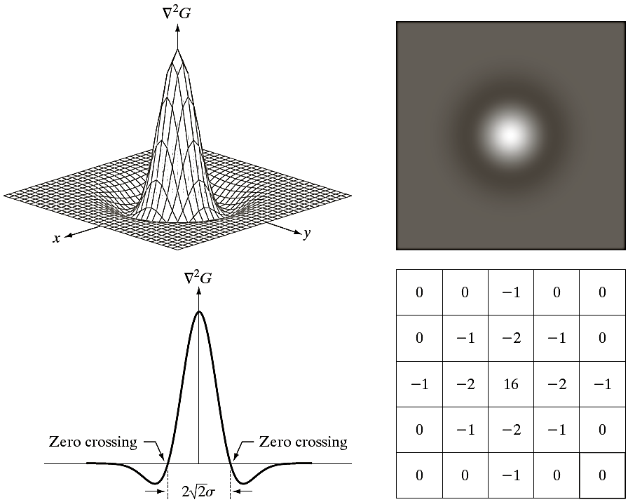
Laplacian Of Gaussian
3D view
Energy Function
The Laplacian of Gaussian (or Mexican hat) filter’s shape in 2D and 3D is given below:
2D view
Digital Approximation

Slide 25
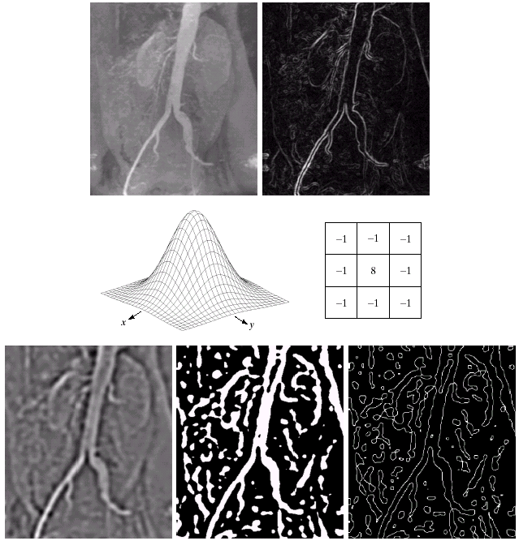
Laplacian Of Gaussian Example

Slide 26
Laplacian Of Gaussian Example

Slide 27
Thresholding
Thresholding is usually the first step in any segmentation approach
We have talked about simple single value thresholding already
Single value thresholding can be given mathematically as follows:

Slide 28
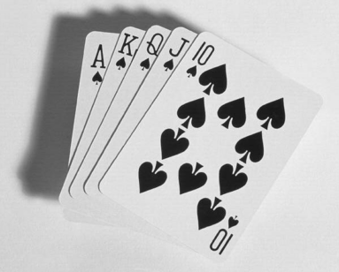

Thresholding Example
Imagine a poker playing robot that needs to visually interpret the cards in its hand
Original Image
Thresholded Image

Slide 29
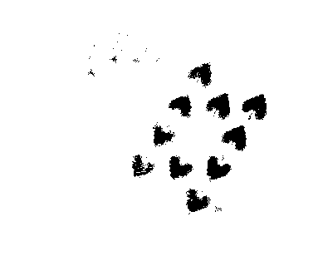
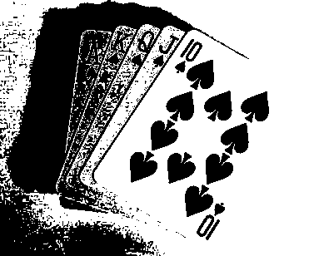
But Be Careful
If you get the threshold wrong the results can be disastrous
Threshold Too Low
Threshold Too High

Slide 30
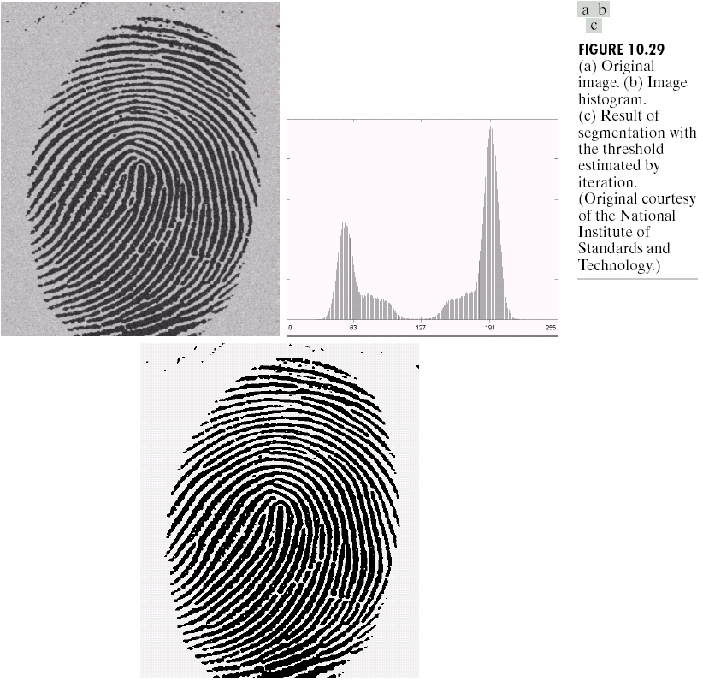
Basic Global Thresholding
Based on the histogram of an image
Partition the image histogram using a single global threshold
The success of this technique very strongly depends on how well the histogram can be partitioned

Slide 31

Basic Global Thresholding Algorithm
The basic global threshold, T, is calculated
as follows:
Select an initial estimate for T (typically the average grey level in the image)
Segment the image using T to produce two groups of pixels: G₁ consisting of pixels with grey levels >T and G₂ consisting pixels with grey levels ≤ T
Compute the average grey levels of pixels in G₁ to give μ₁ and G₂ to give μ₂

Slide 32
Basic Global Thresholding Algorithm
Compute a new threshold value:
Repeat steps 2 – 4 until the difference in T in successive iterations is less than a predefined limit ∆T
This algorithm works very well for finding thresholds when the histogram is suitable; however, it is required to be processed on the entire image and not the histogram.

Slide 33

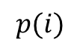
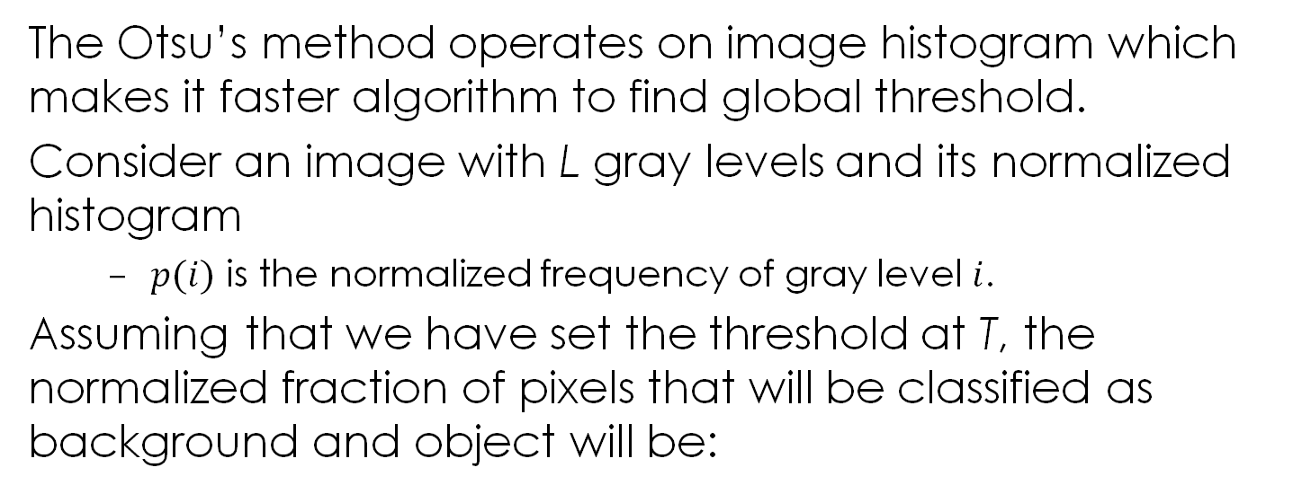
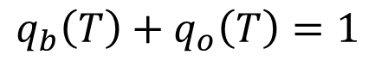
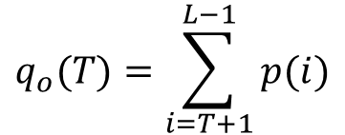
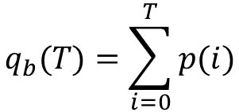
Otsu’s Optimum Global Thresholding Method
The Otsu’s method operates on image histogram which makes it faster algorithm to find global threshold.
Consider an image with L gray levels and its normalized histogram
$p(i)$ is the normalized frequency of gray level $i$.
Assuming that we have set the threshold at T, the normalized fraction of pixels that will be classified as background and object will be:
T
$$p(i)$$
background
object
$$q_{b}(T)=\sum_{i=0}^{T}{p(i)}$$
$$q_{o}(T)=\sum_{i=T+1}^{L−1}{p(i)}$$
$$q_{b}\left(T\right)+q_{o}\left(T\right)=1$$
$$i$$

Slide 34
Otsu’s Method...
The mean gray-level value of the background and the object pixels will be:
The mean gray-level value over the whole image (“grand” mean) is:

Slide 35
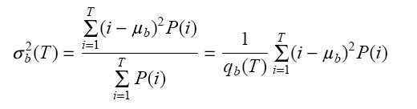
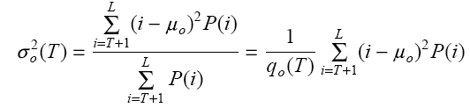
Otsu’s Method...
The variance of the background and the object pixels will be:
The variance of the whole image is:

Slide 36
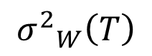
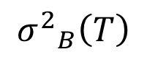
Otsu’s Method...
It can be shown that the variance of the whole image can be written as follows:
Within-class variance
between-class variance
$${σ^{2}}_{W}\left(T\right)$$
$${σ^{2}}_{B}\left(T\right)$$
should be minimized!
should be maximized!
Another way to write between-class variance is:
$${{σ^{2}}_{B}\left(T\right)=q}_{b}\left(T\right){ q}_{o}\left(T\right){ \left[ μ_{b}\left(T\right)−μ_{o}\left(T\right)\right]}^{2}$$
The Otsu’s optimum T is a threshold that either minimizes the within class variance or maximizes the between-class variance.

Slide 37
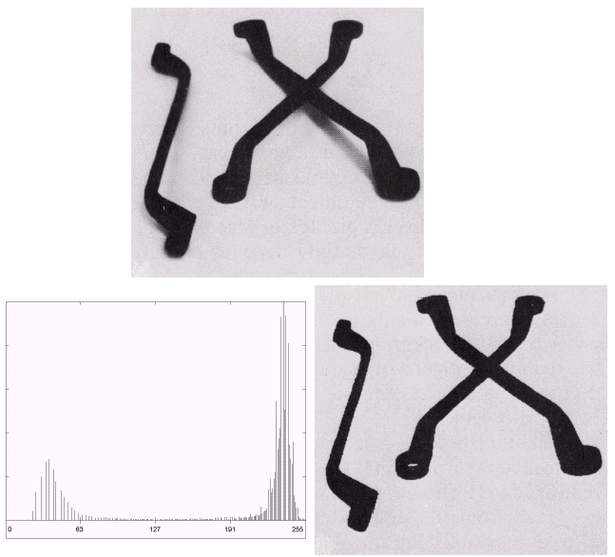
Thresholding Example 1

Slide 38
Thresholding Example 2

Slide 39
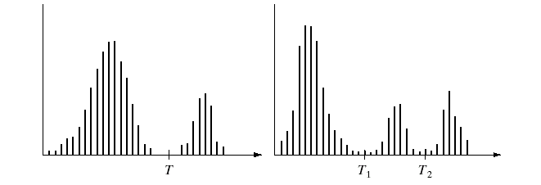
Problems With Single Value Thresholding
Single value thresholding only works for bimodal histograms
Images with other kinds of histograms need more than a single threshold

Slide 40
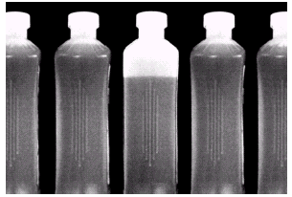
Problems With Single Value Thresholding (cont…)
Let’s say we want to isolate the contents of the bottles
Think about what the histogram for this image would look like
What would happen if we used a single threshold value?

Slide 41
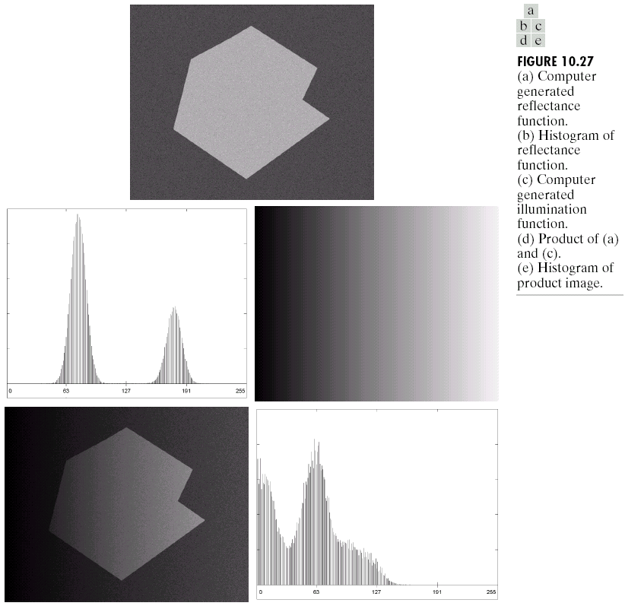
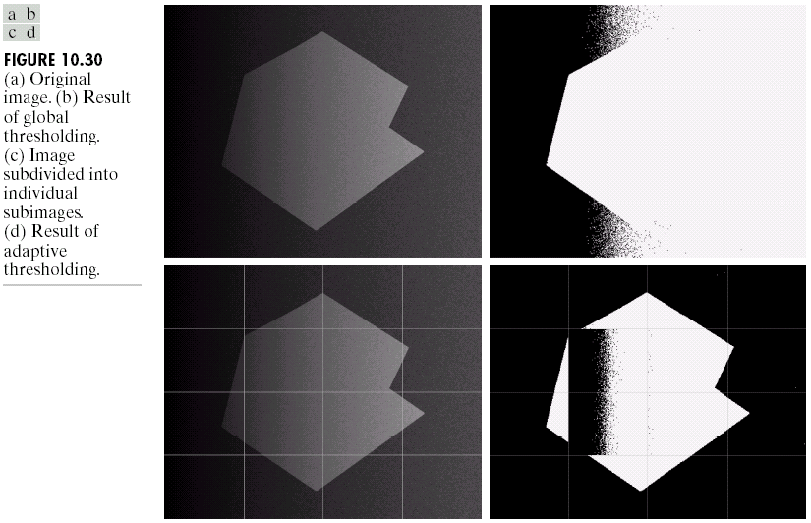
Single Value Thresholding and Illumination
Uneven illumination can really upset a single valued thresholding scheme

Slide 42
Basic Adaptive Thresholding
An approach to handling situations in which single value thresholding will not work is to divide an image into sub images and threshold these individually
Since the threshold for each pixel depends on its location within an image this technique is said to be adaptive

Slide 43
Basic Adaptive Thresholding Example
The image below shows an example of using adaptive thresholding with the image shown previously
As can be seen success is mixed
But, we can further subdivide the troublesome sub images for more success

Slide 44
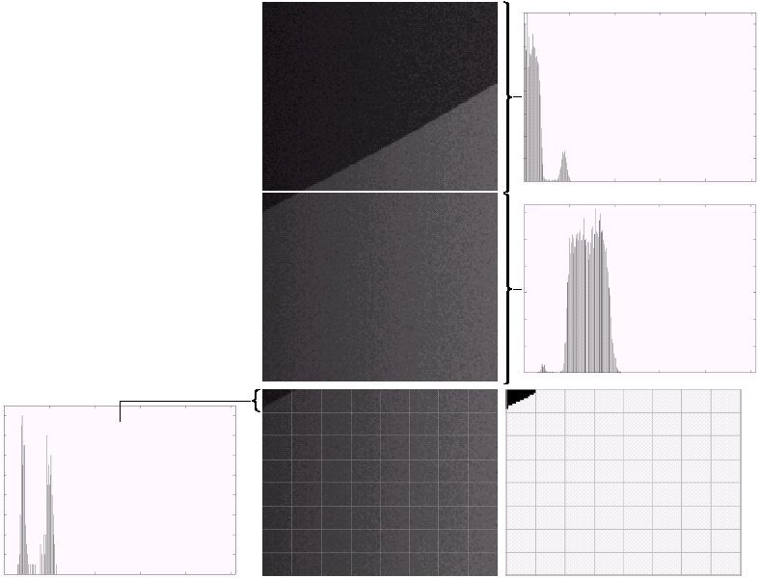
Basic Adaptive Thresholding Example (cont…)
These images show the troublesome parts of the previous problem further subdivided
After this sub division successful thresholding can be achieved

Slide 45
Summary
In this lecture we have begun looking at segmentation, and in particular edge detection
Edge detection is massively important as it is in many cases the first step to object recognition
We have also looked at the very basic type of segmentation i.e., Thresholding and what it offers.

